Slide 2
Git & Github For Beginers
GOURAV KUSHWAHA

Slide 3
Basics to Git, Github, Versioning Systems
GOURAV KUSHWAHA
BETA MLSA

Slide 4




Introduction to
Git & GitHub & Version Control
Presented by: GOURAV KUSHWAHA
Notes:
Good morning good afternoon good evening
Depending on where in the world you might be my name is ..
I’m a ..
As we go through this if you have questions feel free to go ahead and ask them.
One thing to note is that as we go through this if somebody asks a question, I may hold off for a couple of minutes to answer that either to try to keep with the flow or because we are going to answer the question a little bit later but please don’t be shy don’t be afraid at all to ask your questions.

Slide 5
Agenda
What is Version Control?
It’s time to get Git.
Working with repositories locally.
Working with remotes.
Working on another developer’s repository.
Notes:
What are we going to do today?
We are going to get to know what is version control, install git together, work on a local repository, work with remotes on GitHub, and finally we are going to work on another developer’s repository.

Slide 6




What is Version Control?
Time
Who took it
State and Location of pieces
Notes:
To answer this question let me tell you a little story.
Once upon a time, there were two friends playing a game together this game consists of the world map and a small pieces that you use to conquer a piece of land.
Each player starts moving his pieces and the player that conquers the biggest piece of land wins.
The game takes a lot of time as the players are trying to conquer the whole world so, sometimes they pause the game and continue playing next day.
Instead of restarting the game each time they thought of a nice solution which is to keep track of the game state by taking an image of the game board each time they stop playing.
This image has the time included in it, who took the image, and the state and location of game pieces in the image which insured that they always have a safe point they can get back to.

Slide 7
This Idea of a safe point is exactly What Version Control is
Time
Who took it
State and Location of pieces
Notes:
This concept of a safe point is the idea behind version control as we keep track of different version of our code which might include the time, person who created the version, the state of our code at this exact time.

Slide 8
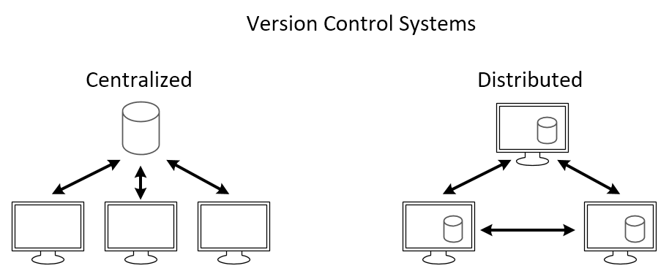
Version Control Systems (VCS)
Centralized (CVCS)
Distributed (DVCS)
Notes:
Centralized, only one device has everything (each device has his own piece of the centralized code)
Distributed, each device has the same version of the code (all the devices are contributing to it at the same time)

Slide 9
Most Popular Version Control Systems
Git
Subversion
Mercurial
Notes:
The centralized and distributed version control systems is a concept that some tools are built on.
Git uses a distributed version control system.
Git uses a centralized version control system.
Git uses a distributed version control system.

Slide 10


Distributed Version Control System.
Version Control Tool
Service hosts Git Projects
Notes:
Mentioning git some of you may think it’s related to GitHub but that’s not true as Git is a version control tool which doesn’t require GitHub to work
While GitHub is a cloud platform for hosting and sharing Git Projects.

Slide 11
Terminology
Branching
Merging
Version Control System
SHA
Staging Index
Merge Conflicts
Source Code Manager
Index
Remotes
Staging area
Repository
Commit
Working Directory
Repo
Checkout
Notes:
There are lots of terminologies out there that we might here about when starting to learn about git and GitHub like:

Slide 12
Terminology
git-cheat-sheet-education (github.com)
Notes:
All of these terminologies are actually used while working with git, but you don’t need to learn about all of them at the beginning but If you prefer learning everything before starting the practical part this git cheat sheet is perfect for you.

Slide 13
Exercise – Install and Configure Git
In this exercise, we will:
Download and install Git.
Perform first time configuration for Git.
Configure Git with out Code Editor.
Notes:
Let’s get started with our first exercise today which is to install and configure git,
In this exercise, we will:
Download and install Git.
Perform first time configuration for Git.
Configure Git with out Code Editor.

Slide 14
How to get Git?
Installing Git
MacOS / Windows
go to git-scm.com/downloads
download the software for Mac/Windows
install Git choosing all of the default options
Linux
$ sudo apt-get install git

Slide 15
First Time Git Configuration
# sets up Git with your name
git config --global user.name "<Your-Full-Name>"
# sets up Git with your email
git config --global user.email "<your-email-address>"
# makes sure that Git output is colored
git config --global color.ui auto

Slide 16
Git & code Editor
Atom Editor Setup
git config --global core.editor "atom --wait"
VSCode Setup
git config --global core.editor "code --wait"

Slide 17
Review Git Configuration
# lists all the configuration properties
git config --list

Slide 18
Exercise – Working with a Local Repository
In this exercise, we will:
Create a Git Local Repository.
Make Changes, add, and commit them.
Review the repository’s history.
Notes:
Let’s get started with our second exercise today which is to working with a local repository,
In this exercise, we will:
Create a Git Local Repository.
Make Changes, add, and commit them.
Review the repository’s history.

Slide 19
Initializing a Local Git Repository
$git init
Common terminal commands
$ls - used to list files and directories
$mkdir - used to create a new directory
$cd - used to change directories
$rm - used to remove files and directories
$pwd - used to print working directory
$touch - used to create and modify files
$start - used to open files or directories

Slide 20
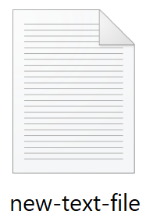
How Git works?
Working Directory
Staging Area
Local Repository
$ git add new-text-file.txt
Notes:
How git works?
To get started, we have three different places or virtual places.
We have the working directory which we have just created our file inside, and we have the staging area which is the intermediate place between saving the changes forever in the local repository or leaving them in an intermediate state in the working directory.
What can we do to ship our changes to the staging area?
Imagine you have a cruise trip, the first thing you do is that you load the ship with your luggage or bags so, to load the ship with our files or code, we use a command called git add and then we give it the name of the file.
For example, we can say git add new-text-file.txt

Slide 21
How Git works?
Working Directory
Staging Area
Local Repository
$ git add new-text-file.txt
$ git commit –m “Message”
Notes:
And it will move our file to the staging area or the staging index which is the intermediate place that we have talked about.
In order to do the next step which is moving the file to the local repository you have to use a command called git commit which makes our changes saved in the git history.
So, to make our changes there we use git commit and we give it a message.
For Example, “Message” any message you want but this message is really important, and we are going to get back to that in another slide but for now there is a command called git commit and we give it a dash m small to specify a specific message, and then a double quotation inside it our message.

Slide 22
How Git works?
Working Directory
Staging Area
Local Repository
$ git add new-text-file.txt
$ git commit –m “Message”
Notes:
And then the file is saved in the local repository.

Slide 23
Git Add
$ git add <file1> <file2> … <fileN>
$ git add .
This command moves your changes to the staging area.

Slide 24
Git Commit
$ git commit –m “Initial commit”
This command moves your changes to the local repository.
Try to always write your commit message in an imperative way.

Slide 25
Git Commit Message
Do’s
Keep the message short (less than 60-ish characters)
Explain what the commit does (not how or why!)
Don’ts
Explain why the changes are made
Explain how the changes are made
Use the word “and”

Slide 26
Reviewing the Repository’s History
$ git status
On branch master
Your branch is up-to-date with 'origin/master'.
Nothing to commit, working directory clean
$ git log

Slide 27
Reviewing the Repository’s History
$ git status
This command display’s the status of the working directory and the staging area.
It doesn’t show us history!

Slide 28
Reviewing the Repository’s History
$ git log
This command will show you the history of changes in the repository including:
the SHA
the author
the date
the commit message
$ git log --oneline

Slide 29
Exercise – Working with Remotes
In this exercise, we will:
Create a GitHub repository and clone it.
Make changes and push to GitHub.
Make changes and pull from GitHub.
Fork a repository and make a pull request.
Notes:
Let’s get started with our third and final exercise today which is to working with remotes,
In this exercise, we will:
Create a GitHub repository and clone it.
Make changes and push to GitHub.
Makes changes and pull from GitHub.
Fork a repository and make a pull request.

Slide 30
How Git works with GitHub?
Working Directory
Staging Area
Local Repository
Remote Repository
$ git add new-text-file.txt
$ git commit –m “Message”
Notes:
So, Again How does git work? But now with GitHub?
There is something new that has been introduced to us which is the remote repository and in our case it’s GitHub.
This remote repository can be used to host our code online so, I can ship my code not just to my local repository but also online to the cloud to share it with others either in a private repository or a public repository which is open to everyone for contribution and for me to move my code from the local repository to the remote repository I have to use a command called git push!

Slide 31
How Git works with GitHub?
Working Directory
Staging Area
Local Repository
Remote Repository
$ git add new-text-file.txt
$ git commit –m “Message”
$ git push
Notes:
Let’s push my code

Slide 32
How Git works with GitHub?
Working Directory
Staging Area
Local Repository
Remote Repository
$ git add new-text-file.txt
$ git commit –m “Message”
$ git push
$ git pull
Notes:
And as you can see the file has been moved to GitHub.
But what if it’s the other way around, I have done some changes on the remote repository and want to see these changes locally.
I can use another command called git pull.

Slide 33
How Git works with GitHub?
Working Directory
Staging Area
Local Repository
Remote Repository
$ git add new-text-file.txt
$ git commit –m “Message”
$ git push
$ git pull
Notes:
And git pull with take the version of the repository that is hosted on GitHub and download it to your local repository.
Let’s see this in action together.

Slide 34
Next Steps
Learn more about GitHub on Microsoft Learn.
Finish Introduction to version control with Git learning path.
Please tell us how you liked this workshop by filling out this survey:
https://aka.ms/workshopomatic-feedback

